Slide 1







Slide 2

AGENDA
Problem Statement
Sudoku Solving Demonstration
Design and implement an AI-powered Sudoku solver in Python using various algorithms, including backtracking, minimum remaining value (MRV), and brute-force techniques.
Demonstrating the solving process of the Sudoku puzzle using three different approaches: Backtracking, Minimum Remaining Value (MRV) heuristic, and Brute-force.
OBJECTIVE
PRESENTATION
Sudoku Solver
DIFFERENTIATION
CONCLUSION
Comparison
Summary
Comparing every the algorithm in the course of development and figure out the most feasible algorithm.
You can simply impress your audience and add a unique zing and appeal to your Presentations. Easy to change colors, photos and Text.

Slide 3



ALGORITHMS IN SUDOKU
SOLVER :
Back-Tracking Technique
Depth-first search approach.
Decision-making at each step.
Backtracking when invalid choices are made.
Minimum Remaining Value
Heuristic approach for decision-making.
Selection based on the least remaining possibilities.
Reduces the search space.
Brute-Force
Naive approach for comparison.
Exhaustive search through all possibilities.

Slide 4
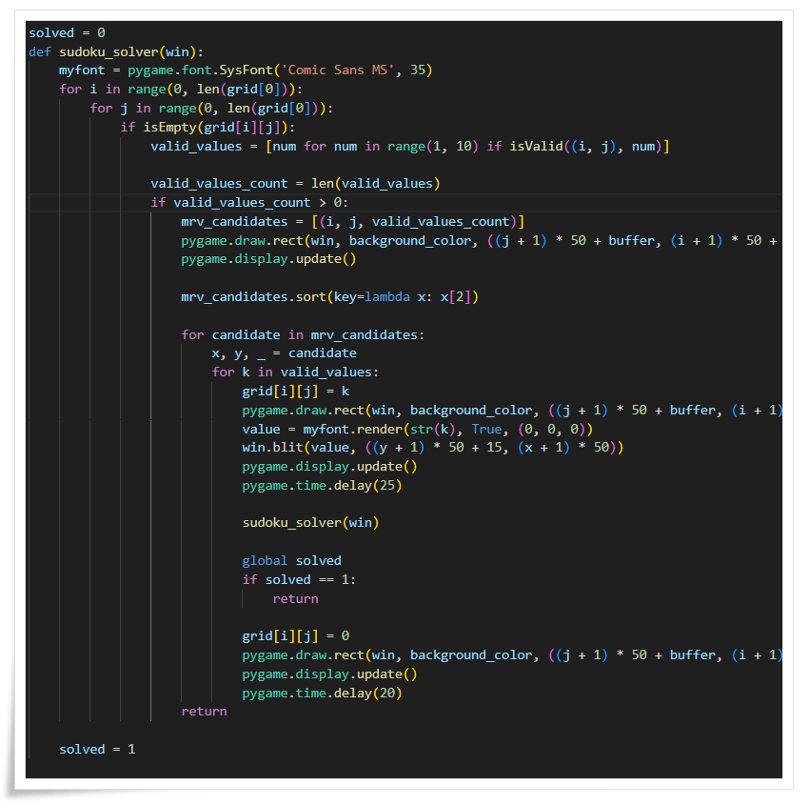
Sudoku Solver Using MRV :
Identifying Constrained Variables:
The first step is to identify the variables (empty cells) that are most constrained. These are the cells with the fewest possible values that can be legally placed in them.
Counting Remaining Values:
For each empty cell, count the number of possible values that can be placed while still satisfying the Sudoku rules.
Selecting the Minimum Remaining Value:
Choose the variable with the minimum remaining values. This means selecting the cell that has the fewest possible legal values.
Exploration and Backtracking:
Once the most constrained variable is identified, the algorithm explores the possibilities for that variable. It might try filling in one of the possible values and continue solving the puzzle. If it reaches a point where a contradiction occurs (a violation of Sudoku rules), it backtracks to the previous state and explores a different value.
Iteration:
The process iterates, selecting the next most constrained variable at each step, until the puzzle is successfully solved or deemed unsolvable.

Slide 5

Pros of using MRV (Minimum Remaining Value) in AI Sudoku Solver:
Efficiency Improvement: MRV focuses on selecting the variable with the fewest remaining values, leading to more efficient decision-making.
Reduction of Search Space: By choosing the variable with the minimum remaining values, MRV often reduces the branching factor, limiting the search space.
Better Handling of Complex Puzzles: MRV is particularly effective in handling complex Sudoku puzzles by strategically selecting variables during the solving process.
Enhanced Backtracking: When combined with backtracking, MRV improves the overall performance of the solver by guiding the search towards more promising solutions.

Slide 6
Cons of using MRV (Minimum Remaining Value) in AI Sudoku Solver:
Possible Overhead: Implementing MRV may introduce some overhead due to the need for additional computations to determine the remaining values for each variable.
Dependency on Puzzle Characteristics: The effectiveness of MRV may vary based on the characteristics of the Sudoku puzzle. It might not always provide a significant advantage.
Complexity of Implementation: Implementing MRV requires additional logic and tracking of remaining values, adding complexity to the solver.
Possibility of Premature Selection: In some cases, selecting the variable with the minimum remaining values might lead to premature decisions, affecting the overall solving strategy.

Slide 7

Guys, Put Heading Text Here
And Description Text

Slide 8
Guys, Put Heading Text Here
And Description Text

Slide 9
Conclusion
In conclusion, the Sudoku Solver Project has been a thorough investigation of numerous artificial intelligence algorithms designed to solve Sudoku puzzles. By applying three different strategies—Backtracking, the Minimum Remaining Value (MRV) Heuristic, and Brute-force—we have examined the advantages and disadvantages of each approach.
The comparative study showed that every algorithm has particular advantages and disadvantages. Efficiency gains can be achieved with Backtracking and MRV by means of systematic exploration and optimized variable selection. Although brute-force guarantees a solution, it is not scalable for larger puzzles.
The choice of algorithm depends on factors such as puzzle complexity, desired efficiency, and available computational resources. Backtracking and MRV can be suitable for different scenarios, with MRV being particularly effective for puzzles with complex patterns. Brute-force, while less efficient, remains a fallback for guaranteeing solutions.

Slide 10
Thank You!
Pranjal, Aayush, Santosh, Shriya

